Slide 1


Multi-Agent Deep Reinforcement Learning for Liquidation Strategy Analysis
Reproduced by Janet Wang
December 5, 2020

Slide 2



Motivation
Liquidation is the sale of stock shares by financial institutions to minimize implementation shortfall and manage risk level for investors wanting to cash out
Implementation shortfall is the difference between decision price and the final execution price of the trade. Since market price drops during liquidation, a trading cost occurs.
Liquidation of large number of stock shares would have huge impact on the dynamic market, making the environment difficult to predict
Multiple organizations may want to liquidate their assets under certain market conditions at the same time
Gomber et al., 2011
Brogaard et al., 2010
Sutton & Barto, 2018…
This paper
In the past, banks rely on experienced traders to minimize trading cost
Single-agent RL is widely discussed but ignores the stochastic and interactive nature of the market
Multi-agent RL can adapt to high market complexity and derive more practical liquidation strategies
Notes:
The motivation of this project

Slide 3
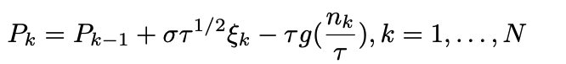
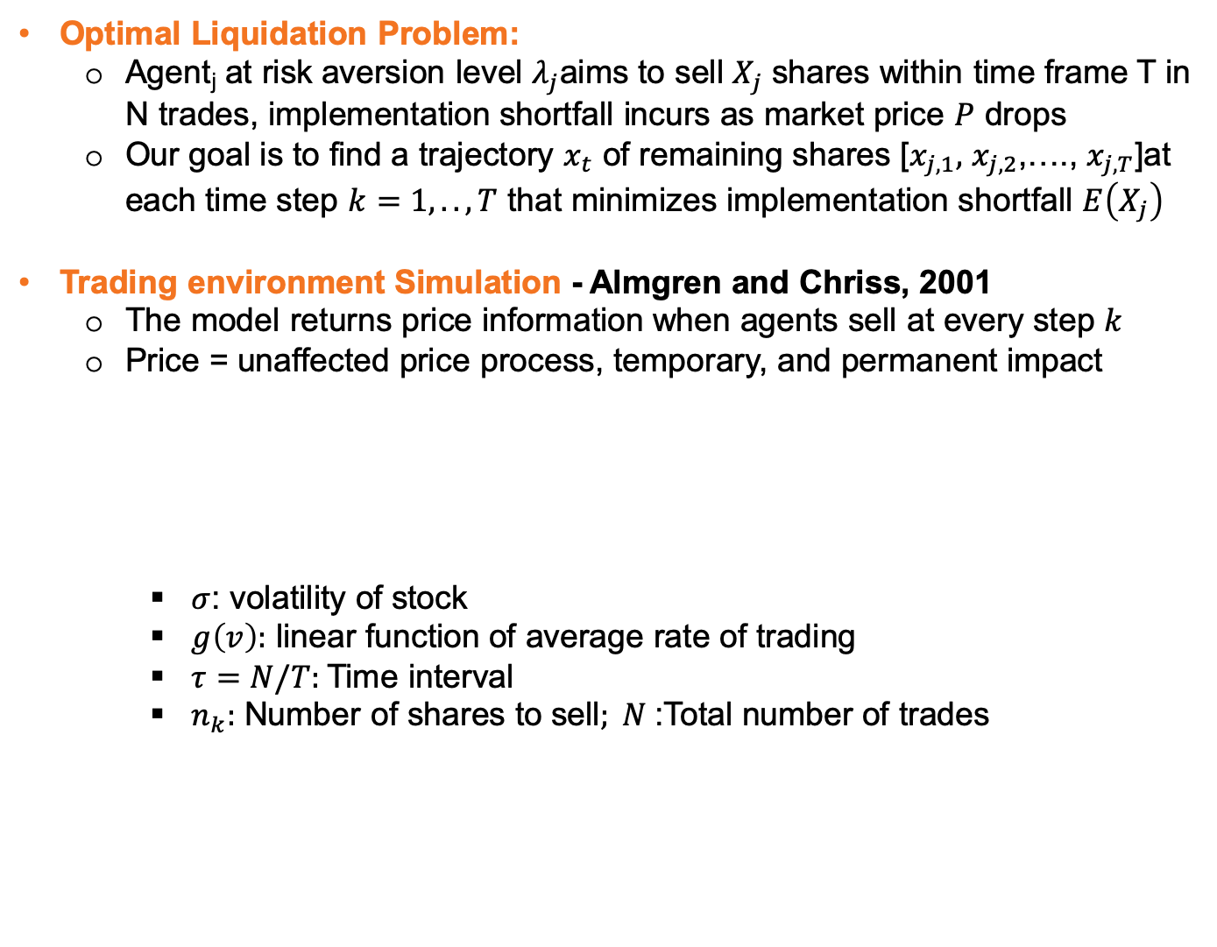
Background I: Liquidation Setup
Optimal Liquidation Problem:
Agent_{j} at risk aversion level $λ_{j}$aims to sell $X_{j}$ shares within time frame T in N trades, implementation shortfall incurs as market price $P$ drops
Our goal is to find a trajectory $x_{t}$ of remaining shares [$x_{j,1},$ $x_{j,2}$,…., $x_{j,T}$]at each time step $k=1,..,T$ that minimizes implementation shortfall $E\left(X_{j}\right)$
Trading environment Simulation - Almgren and Chriss, 2001
The model returns price information when agents sell at every step $k$
Price = unaffected price process, temporary, and permanent impact
$σ$: volatility of stock
$g\left(v\right):$ linear function of average rate of trading
$τ=N/T:$Time interval
$n_{k}:$ Number of shares to sell$; N$:Total number of trades
Discrete arithmetic random walk
Market impact
Notes:
We theoretically analyze the Almgren and Chriss Model and extend its fundamentals so that it can be used as the multi-agent trading environment
The model serves as a trading environment such that when agents make selling decisions, the environment returns price

Slide 4
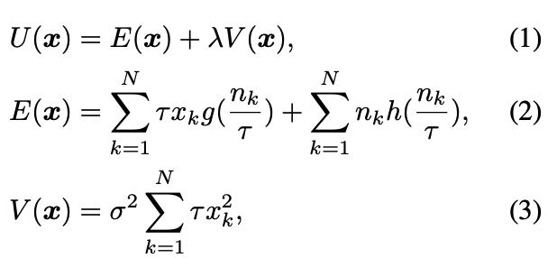
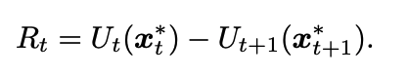
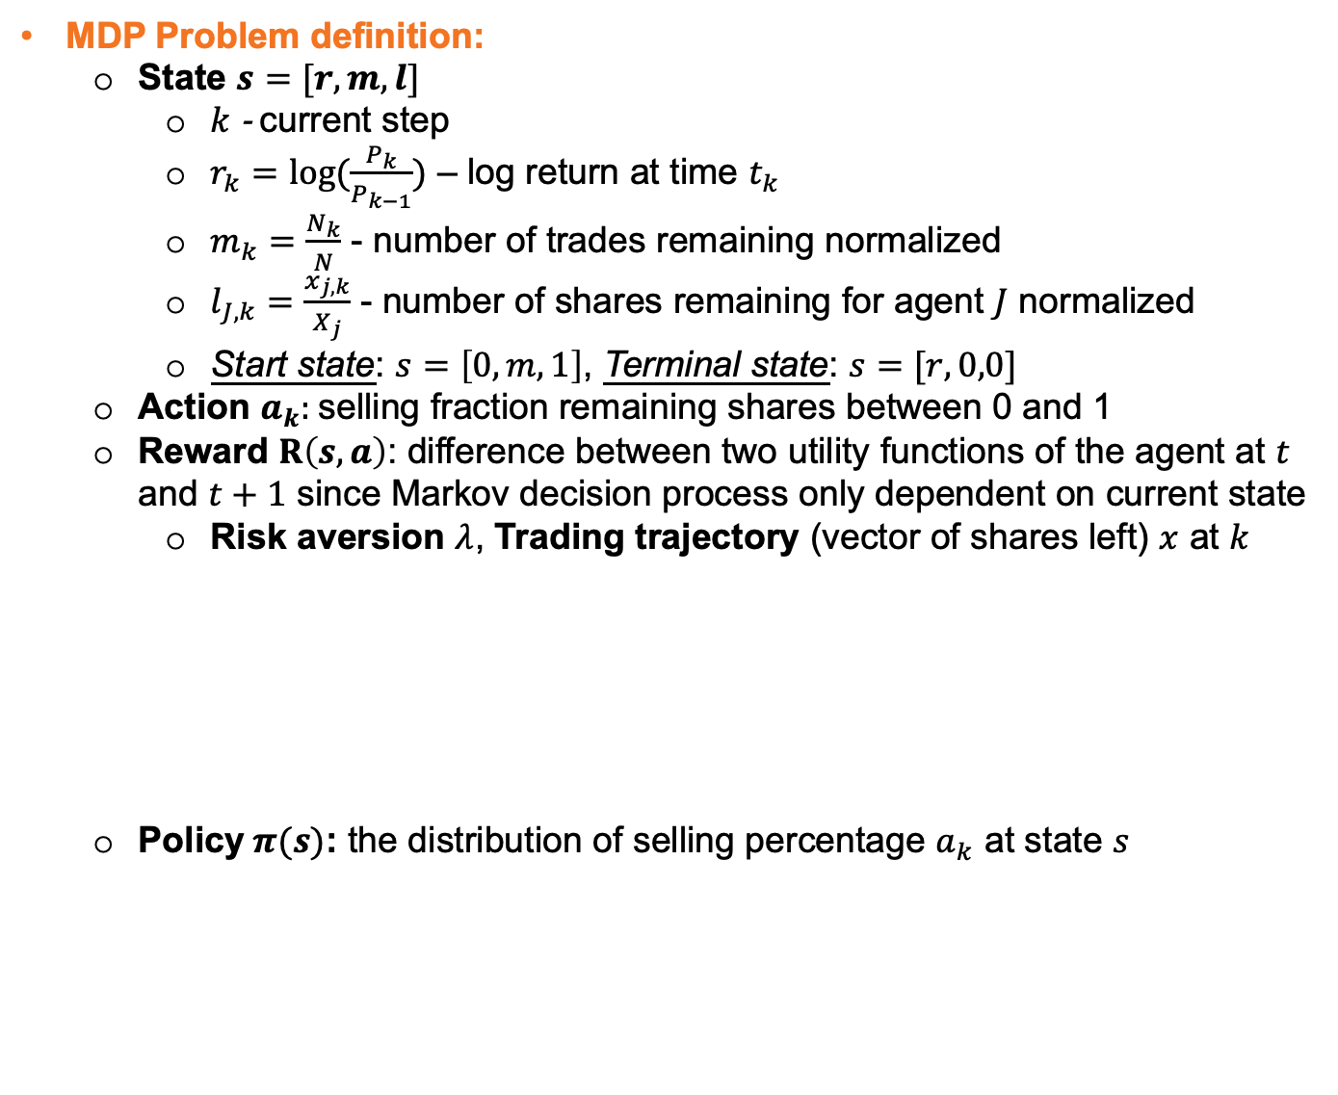
Background II: Liquidation as a MDP
MDP Problem definition:
State $s=[r,m,l]$
$k$ - current step
$r_{k}=log⁡(\frac{P_{k}}{P_{k−1}})$ – log return at time $t_{k}$
$m_{k}=\frac{N_{k}}{N}$ - number of trades remaining normalized
$l_{J,k}=\frac{x_{j,k}}{X_{j}}$ - number of shares remaining for agent $J$ normalized
Start state: $s=\left[0,m,1\right]$, Terminal state: $s=[r,0,0]$
Action $a_{k}:$selling fraction remaining shares between 0 and 1
Reward $R\left(s,a\right)$: difference between two utility functions of the agent at $t$ and $t+1$ since Markov decision process only dependent on current state
Risk aversion $λ$, Trading trajectory (vector of shares left) $x$ at $k$
Policy $π(s)$: the distribution of selling percentage $a_{k}$ at state $s$
v
Expected implementation shortfall
Cost of trading factored in here
Function of trading trajectory

Slide 5
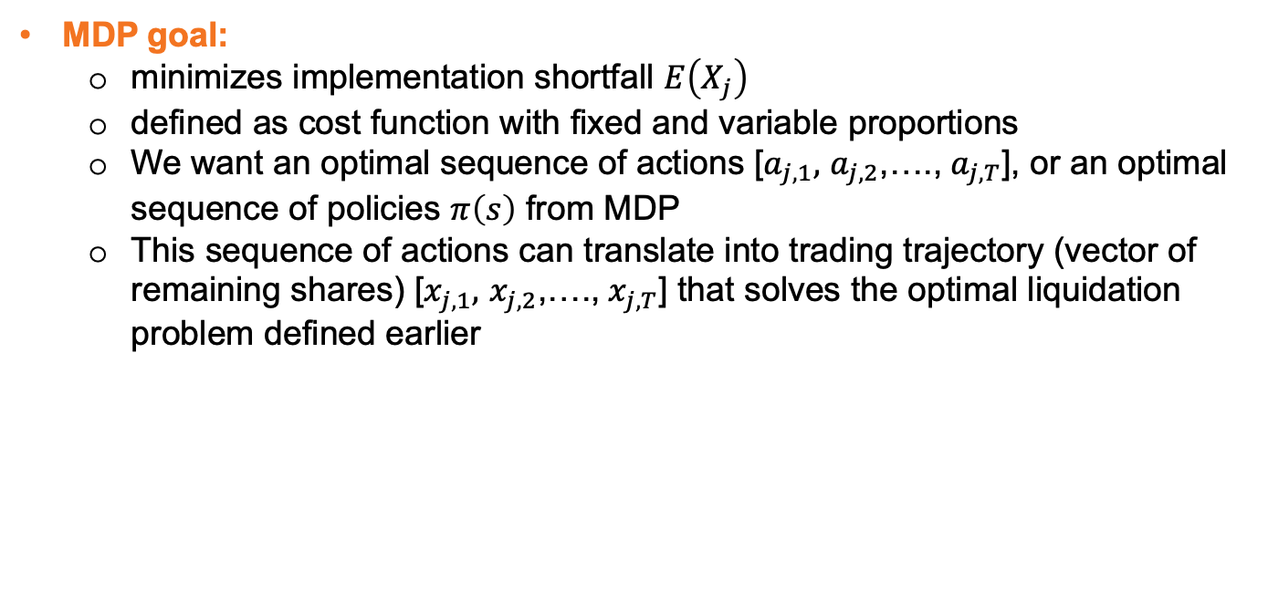
Background II (cont’d)
MDP goal:
minimizes implementation shortfall $E\left(X_{j}\right)$
defined as cost function with fixed and variable proportions
We want an optimal sequence of actions [$a_{j,1},$ $a_{j,2}$,…., $a_{j,T}$], or an optimal sequence of policies $π\left(s\right)$ from MDP
This sequence of actions can translate into trading trajectory (vector of remaining shares) [$x_{j,1},$ $x_{j,2}$,…., $x_{j,T}$] that solves the optimal liquidation problem defined earlier

Slide 6
Related Work
Yang et al., 2018a
Reinforcement learning algorithms
Almgren & Chriss, 2001
Problem of optimal liquidation strategy is investigated by the impact model that agents liquidate assets completely in a given time frame
Impact of the stock market is divided into three components
Unaffected price process
Permanent impact
Temporary impact
Other researches related to deep reinforcement learning algo
Omidshafiei at., 2017
Mnih et al., 2016; Lowe et al., 2017
Lillicrap et al., 2016
Wang et al., 2016

Slide 7
Target Task
Extend to multi-agent trading environment
Prove two theorems to conclude with necessity of using multi-agent RL
Analyze how cooperative and competitive relationship between two trading agents would affect implementation shortfall
Derive an optimal liquidation strategy for a known agent
Notes:
The single-agent environment is a special case where all number of agents J=1. It simplifies the problem and would automatically inherit all properties from the multi-agent environment

Slide 8
Multi-agent RL is necessary to derive trading strategy
Notes:
Reinforcement learning – consists of agents interacting with the environment to learn an optimal policy by trial and error for sequential decision making problems
The main benefit of using reinforcement learning for liquidation is that mathematical methods or hard-coding trading strategy can be avoided
Reinforcement learning agent would learn the trading strategy on its own
Take into account high-level environment complexities and derive more practical liquidation strategies according

Slide 9

Proposed Solution Multi-agent
Extend Single-agent reinforcement learning to multi-agent setting
For 1 episode
Agent
Risk aversion
Action
State
Goal
Reward
State_{t+1}
Price_{t+1}
Reward_{t}
Observation
Action_{t}
State_{t}
Environment
Price_{t+1}
Historical Price_{t}
Time remaining
Action_{t} of other agents
Notes:
We feed states observed from our simulator to each agent. These agents first predict actions using the actor model and perform these actions in the environment.
The the environment returns their rewards and new states. This process continues for a given number of episodes

Slide 10
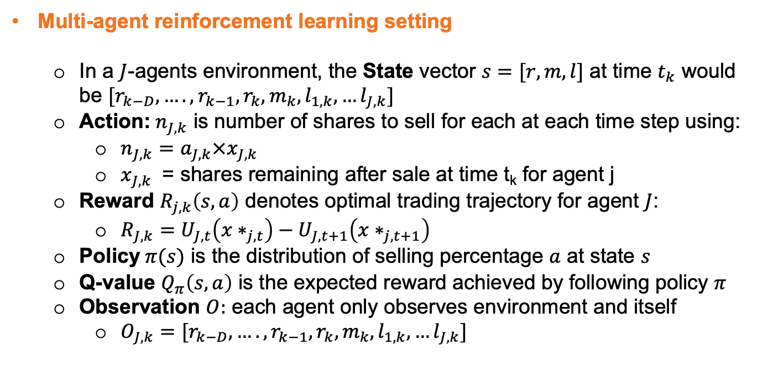
Proposed Solution (cont’d)
Multi-agent reinforcement learning setting
In a $J$-agents environment, the State vector $s=[r,m,l]$ at time $t_{k}$ would be $[r_{k−D},….,r_{k−1},r_{k},m_{k},l_{1,k},…l_{J,k}]$
Action:${ n}_{J,k}$ is number of shares to sell for each at each time step using:
$n_{J,k}=a_{J,k}×x_{J,k}$
$x_{J,k}$ = shares remaining after sale at time t_{k} for agent j
Reward $R_{j,k}\left(s,a\right)$ denotes optimal trading trajectory for agent $J$:
$R_{J,k}=U_{J,t}\left({x∗}_{j,t}\right)−U_{J,t+1}\left({x∗}_{j,t+1}\right)$
Policy $π(s)$ is the distribution of selling percentage $a$ at state $s$
Q-value $Q_{π}\left(s,a\right)$ is the expected reward achieved by following policy $π$
Observation $O:$ each agent only observes environment and itself
$O_{J,k}=[r_{k−D},….,r_{k−1},r_{k},m_{k},l_{1,k},…l_{J,k}]$

Slide 11
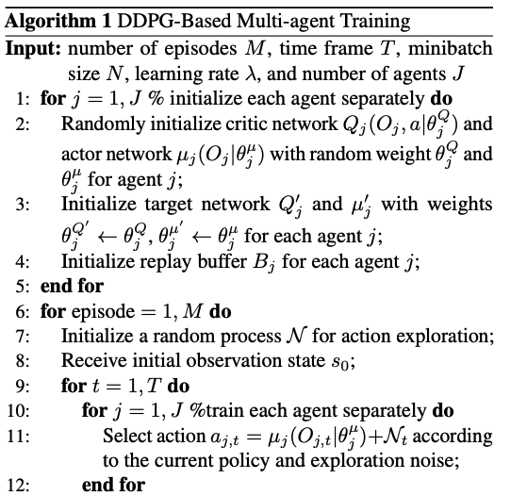
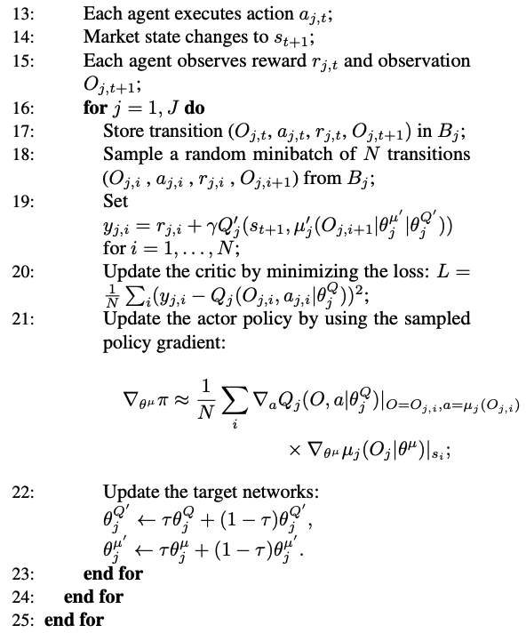
Implementation: Actor-Critic in DDPG
Actor-Critic Model – Mnih and Lowe, 2017
Uses neural network to approximate both Q-value and the action
The critic learns the Q-value function and updates policy parameters
The actor brings the advantage of computing continuous actions without the need of a Q-value function
The critic supplies actor knowledge of performance
The method has good convergence properties
Notes:
DDPG algorithm is an example of an actor-critic method. We will use DDPG to generate the optimal execution strategy of liquidation
With training skills given by DDPG, the agent would learn from trail and error and find the optimal trading trajectory that minimizes the trading cost
In other words, we will use DDPG to solve the optimal liquidation problem

Slide 12
Implementation: Process Overview
Define liquidation problem
Solve liquidation problem
Market Environment
SyntheticChrissAlmgren.py
Default setup of market
DDPG Algorithm
Actor, Critic: model.py
Model_training.ipynb
Agents
1. Agents’ para:
SyntheticChrissAlmgren.py
2. Action, state, risk level…:
ddpg_agent.py
One or two agents’ setup
Solution
Experiment
Visualization.ipynb
Expected shortfall, trading trajectory, of Agent 1,2
Shortfall.npy
trajectory.npy
Utilsgiven.py
Counted as one piece of experiment data

Slide 13
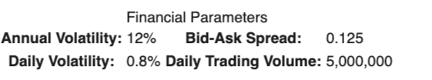
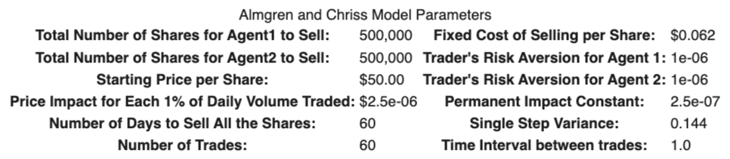
Data Summary
Market setup
Default setting for all experiments
Based on hypothetical assumption: total shares = 1 million
Initial stock price = 50, T = 60 days with N=60 trades, 1 trade/day
Agents setup
redefine the following parameters every time as we run a new experiment to get arrays of expected shortfalls and trajectories
Notes:
Here, we make the claim of this project.

Slide 14
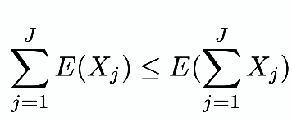
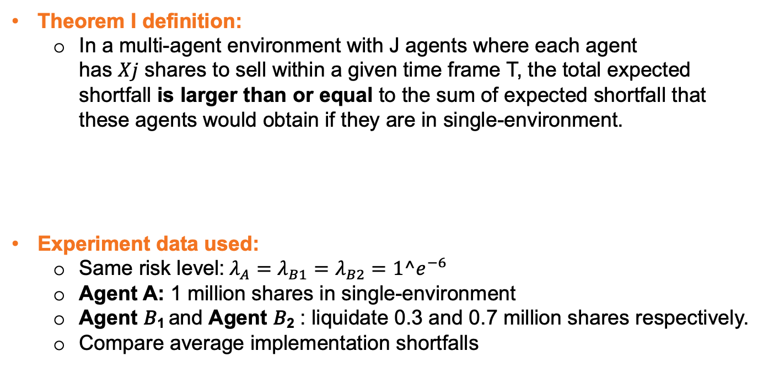
Experiment 1: Theorem I Verification
Theorem I definition:
In a multi-agent environment with J agents where each agent has 𝑋𝑗 shares to sell within a given time frame T, the total expected shortfall is larger than or equal to the sum of expected shortfall that these agents would obtain if they are in single-environment.
Experiment data used:
Same risk level: $λ_{A}=λ_{B1}=λ_{B2}=1^e^{−6}$
Agent A: 1 million shares in single-environment
Agent 𝐵₁ and Agent 𝐵₂ : liquidate 0.3 and 0.7 million shares respectively.
Compare average implementation shortfalls
Notes:
Here, we make the claim of this project.

Slide 15
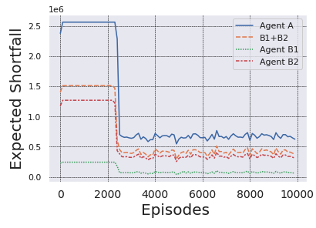
Experimental Result 1:
The expected implementation shortfall 𝐸(𝐴) is larger than the sum of 𝐸(𝐵₁)+𝐸(𝐵₂)
Theorem 1 is proved.
Notes:
Here, we make the claim of this project.

Slide 16
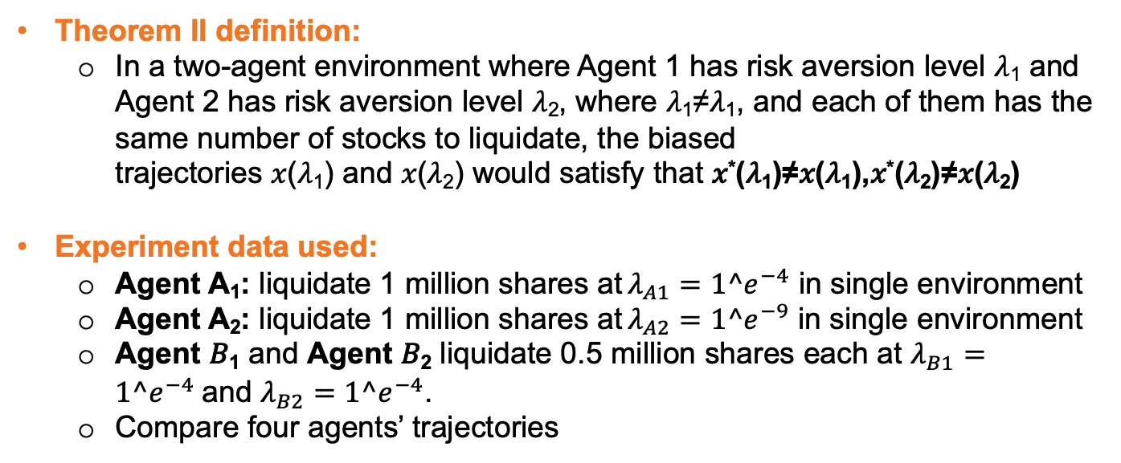
Experiment 2: Theorem II Verification
Theorem II definition:
In a two-agent environment where Agent 1 has risk aversion level 𝜆₁ and Agent 2 has risk aversion level 𝜆₂, where 𝜆₁≠𝜆₁, and each of them has the same number of stocks to liquidate, the biased trajectories 𝑥(𝜆₁) and 𝑥(𝜆₂) would satisfy that 𝑥*(𝜆₁)≠𝑥(𝜆₁),𝑥*(𝜆₂)≠𝑥(𝜆₂)
Experiment data used:
Agent A₁: liquidate 1 million shares at $λ_{A1}=1^e^{−4}$ in single environment
Agent A₂: liquidate 1 million shares at $λ_{A2}=1^e^{−9}$ in single environment
Agent 𝐵₁ and Agent 𝐵₂ liquidate 0.5 million shares each at $λ_{B1}=1^e^{−4}$and $λ_{B2}=1^e^{−4}$.
Compare four agents’ trajectories
Notes:
Here, we make the claim of this project.

Slide 17
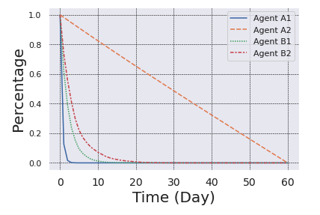
Experimental Result 2:
By comparing trajectories of A₁, A₂ with B₁, B₂ from the graph below, we notice that the trading trajectories of B₁, B₂ are biased
Theorem 2 is proved.
Notes:
Here, we make the claim of this project.

Slide 18
Experimental Analysis 1 & 2
For same amount of shares, shortfall implementation is greater if it is liquidated by one agent than multiple agents
Agents in multi-agent environment factors in extra information from observing other agents in the environment when deciding their trading trajectory
The selling patterns of other agents would affect their liquidation strategy
This demonstrates the necessity of using multi-agents RL to derive trading strategy
Notes:
Here, we make the claim of this project.

Slide 19
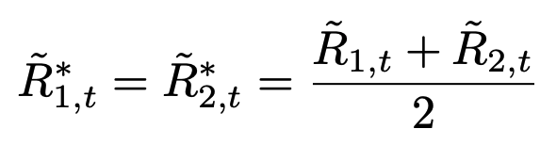
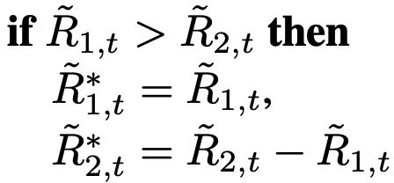
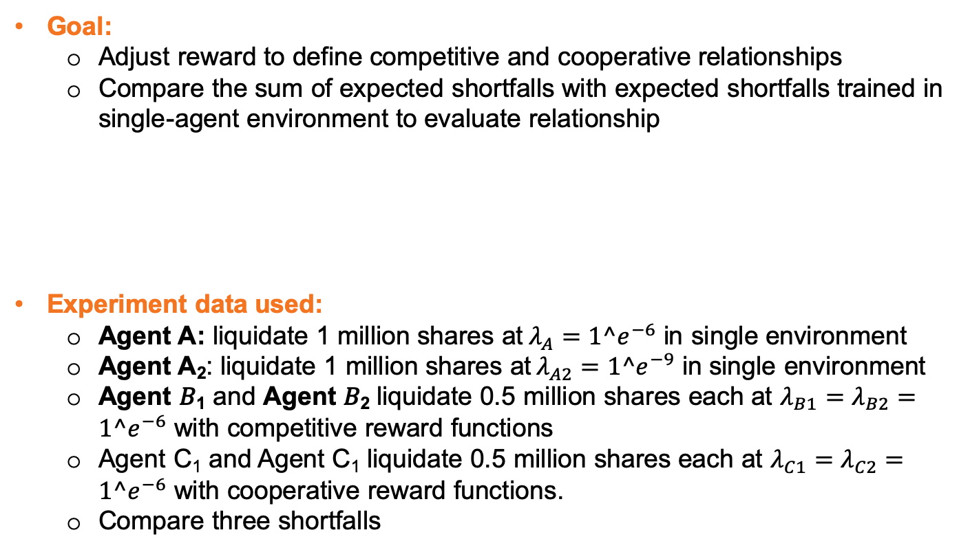
Experiment 3: Relationship analysis
Goal:
Adjust reward to define competitive and cooperative relationships
Compare the sum of expected shortfalls with expected shortfalls trained in single-agent environment to evaluate relationship
Experiment data used:
Agent A: liquidate 1 million shares at $λ_{A}=1^e^{−6}$ in single environment
Agent A₂: liquidate 1 million shares at $λ_{A2}=1^e^{−9}$ in single environment
Agent 𝐵₁ and Agent 𝐵₂ liquidate 0.5 million shares each at $λ_{B1}=λ_{B2}=1^e^{−6}$ with competitive reward functions
Agent C₁ and Agent C₁ liquidate 0.5 million shares each at $λ_{C1}=λ_{C2}=1^e^{−6}$ with cooperative reward functions.
Compare three shortfalls
Corporation
Competition
Notes:
Cooperative: both agents would be rewarded by the sum of their individual rewards
Competitive: the agent that gets higher reward would keep it, but the agent with lower reward would be penalized

Slide 20
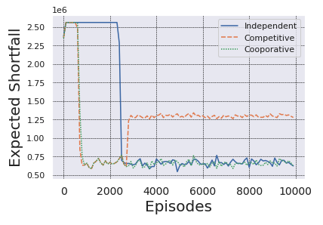
Experimental Result 3:
Two cooperative agents are not necessarily better than independent agents training with independent rewards
Two competitive agents learns to minimize expected shortfall faster than other types of agents, and then malignant competition leads to significant increase in shortfall increment
Notes:
Here, we make the claim of this project.

Slide 21
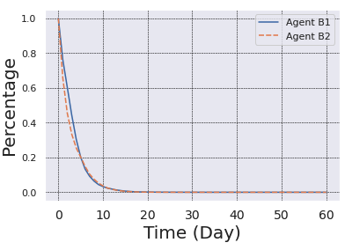
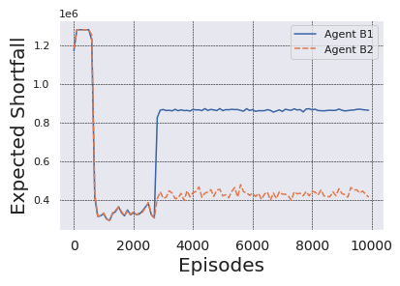
Experimental Analysis 3:
We look deeper into how agents would behave in competitive relationships:
Two competitive agents learns to sell all shares at similar pace
Both agents perform well and roughly have same expected shortfalls but one starts to outperform significantly at the cost of other
E(X) for both agent increases; none of them is winning
Notes:
Here, we make the claim of this project.

Slide 22
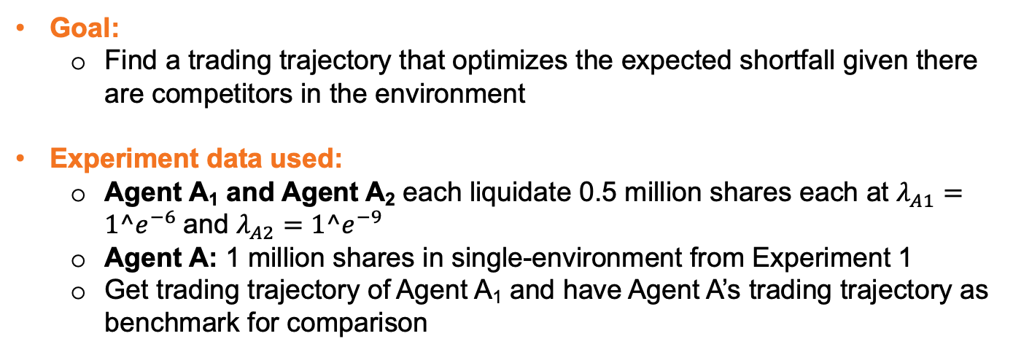
Experiment 4: Strategy Development
Goal:
Find a trading trajectory that optimizes the expected shortfall given there are competitors in the environment
Experiment data used:
Agent A₁ and Agent A₂ each liquidate 0.5 million shares each at $λ_{A1}=1^e^{−6}$and $λ_{A2}=1^e^{−9}$
Agent A: 1 million shares in single-environment from Experiment 1
Get trading trajectory of Agent A₁ and have Agent A’s trading trajectory as benchmark for comparison
Notes:
Here, we make the claim of this project.

Slide 23
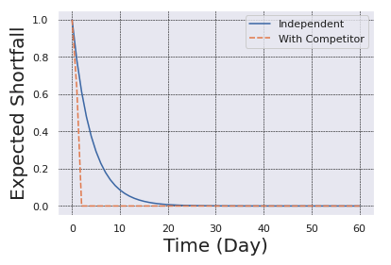
Experimental Result & Analysis 4:
Without competitors, Agent A normally completes in 20 days
With competitors, Agent A₁ normally sells in 2 days
Agents learn to avoid taking unnecessary risk by selling all shares in quite a short time.
Notes:
Here, we make the claim of this project.

Slide 24

Conclusion & Future Work
Conclusion
Single-agent environment over-simplifies the dynamic as well as the interactive nature of the stock market.
We extend the Almgren-Chriss model with reinforcement learning to set up the basis of using multi-agent trading environment to have a better analysis of expected shortfalls
Future work
Development of more realistic trading environment
Include more dynamic factors such as news, general strategy and legal complaints
Notes:
Here, we make the claim of this project.

Slide 25

Conclusion & Future Work (cont’d)
Conclusion
Cooperative relationship is not better than independent one
Competitive relationship would hurt overall and individual performance
Agents with competitor liquidate faster to avoid risk
Future work
Consider optimistic bull or pessimistic bear
Use this as an application to predict stock price movements after liquidation
Notes:
Here, we make the claim of this project.

Slide 26
References
Almgren, R. and Chriss, N. Optimal execution of portfolio transactions. Journal of Risk, 3:5–40, 2001.
Bansal, T., Pachocki, J., Sidor, S., Sutskever, I., and Mordatch, I. Emergent complexity via multi-agent competition. arXiv preprint arXiv:1710.03748, 2017.
Brogaard, J. A., Brennan, T., Korajczyk, R., Mcdonald, R., and Vissing-jorgensen, A. High frequency trading and its impact on market quality, 2010. Buehler, H., Gonon, L., Teichmann, J., and Wood, B. Deep hedging. Quantitative Finance, pp. 1–21, 2019.
Foerster, J., Nardelli, N., Farquhar, G., Afouras, T., Torr, P. H., Kohli, P., and Whiteson, S. Stabilising experience replay for deep multi-agent reinforcement learning. In Proceedings of the 34th International Conference on Machine Learning-Volume 70, pp. 1146–1155. JMLR. org, 2017
…

Slide 27
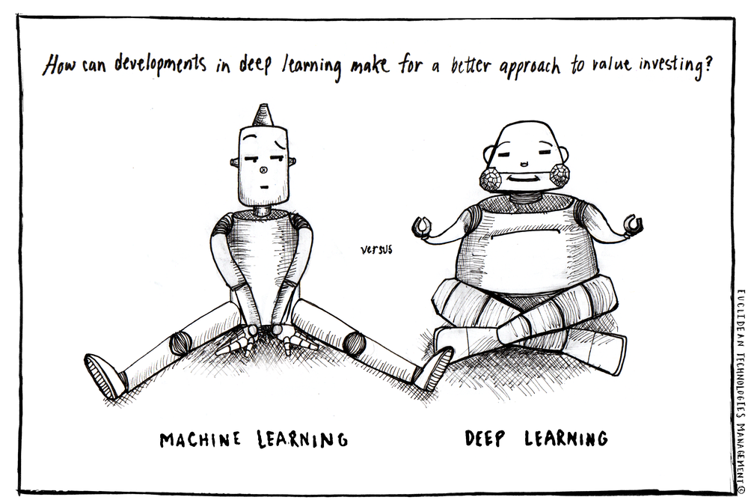
Thank you!

